Slide 1
Games Proposal
By the Spoopy Brigade
(Vic, Kirsty, Will, Phil, Sam)

Slide 2



Game idea: Insert Name Here
Scare everyone out of town to graduate Spoopy School!
Theme of ‘Interference’.
3D perspective isometric
Single-player (and multiplayer)
Difficulty progression
Cutesy style
Family friendly

Slide 3
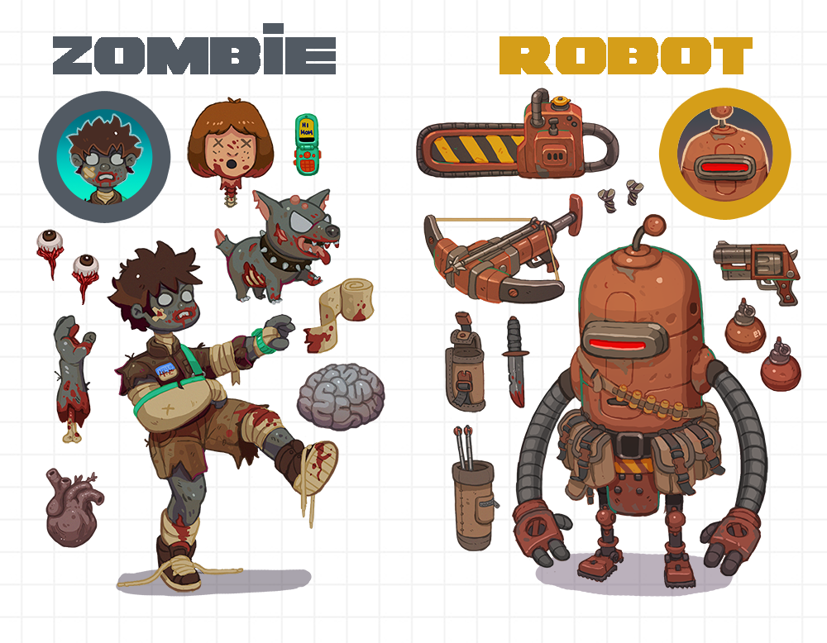
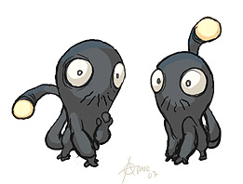
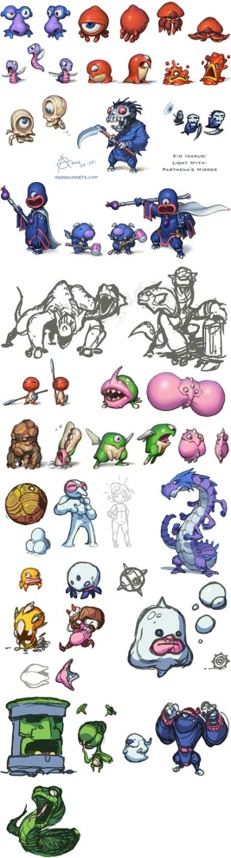
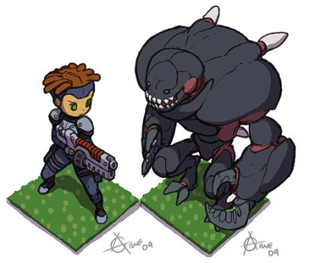
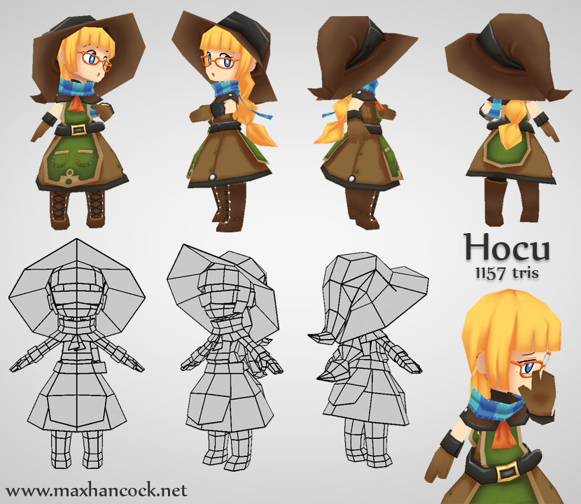
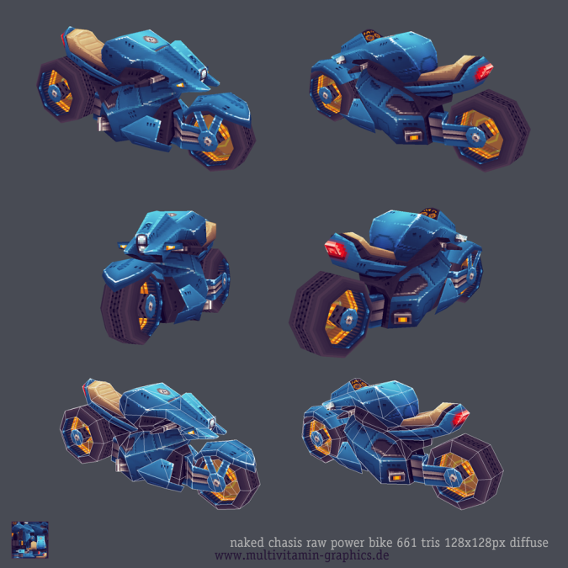

Slide 4
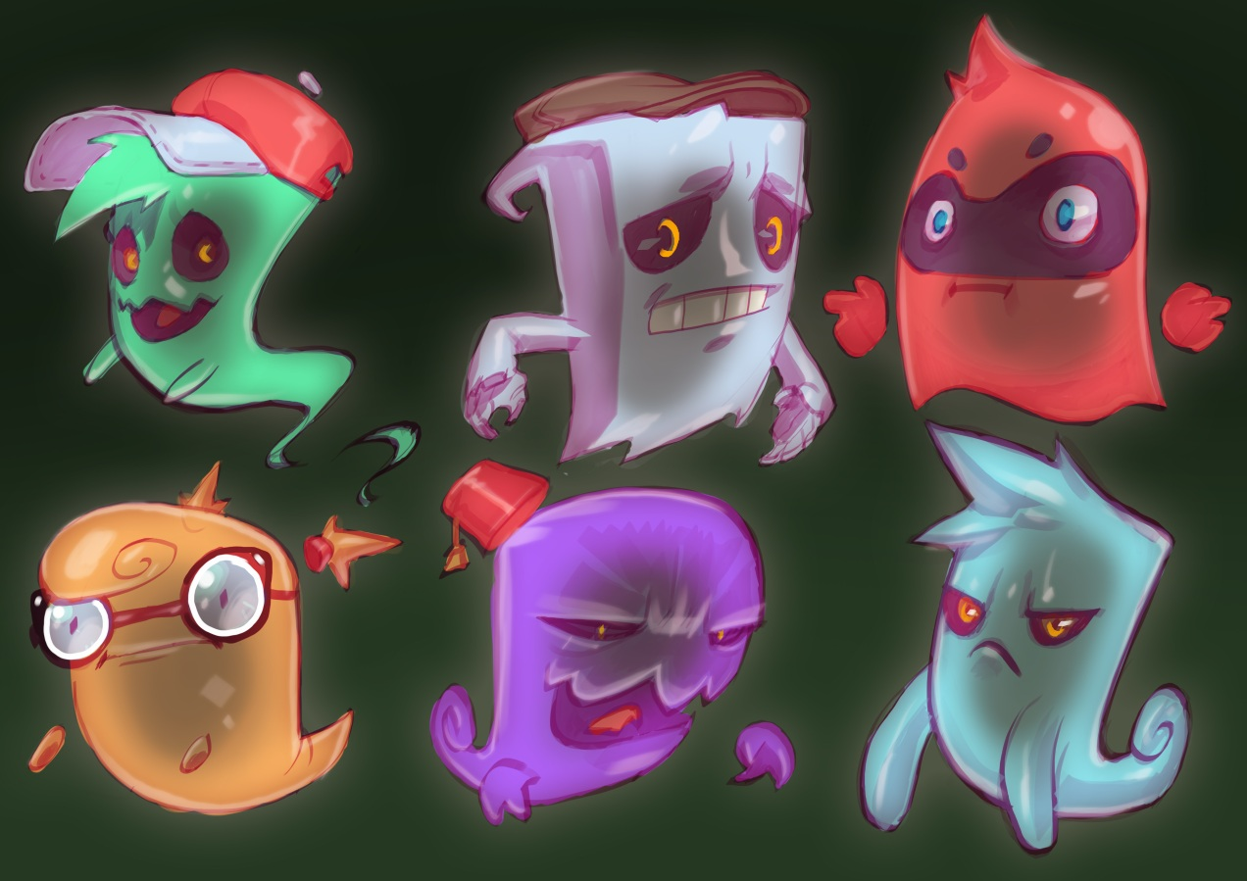
Characters
Player as a ghost in-training
Player/Ghost’s Mentor (Sensei-Sempai Spoop)
‘Spooperscoopers’ (Not-Ghostbusters)
Townspeople
Exorcist boss
Bully ghost
Ghost’s graduation buddies

Slide 5

Areas
Main hub (Spoopy House)
Main town/ Level Select
Houses/Levels
Increase in difficulty
Containing possess-able furniture
Repeated assets but moved around
Cathedral/Boss
Final challenge for the player
Contains an exorcist as the final boss

Slide 6
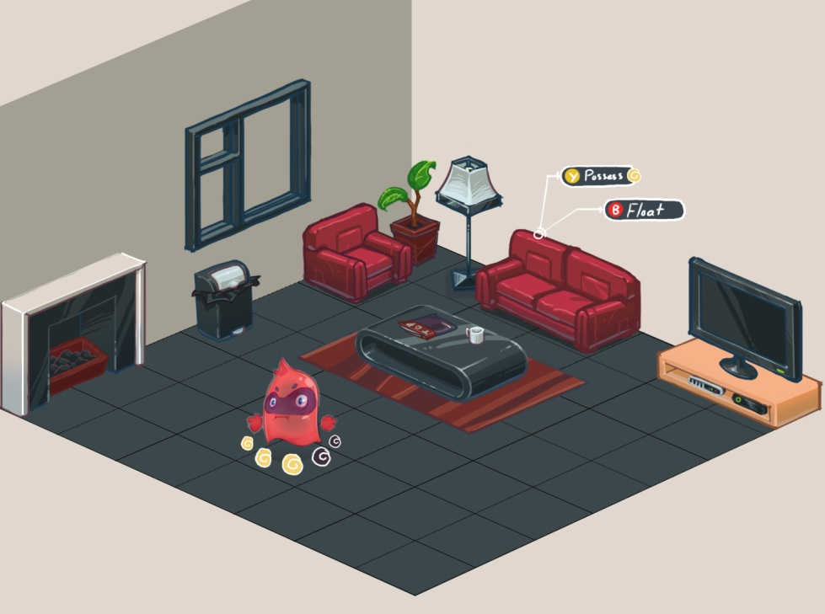
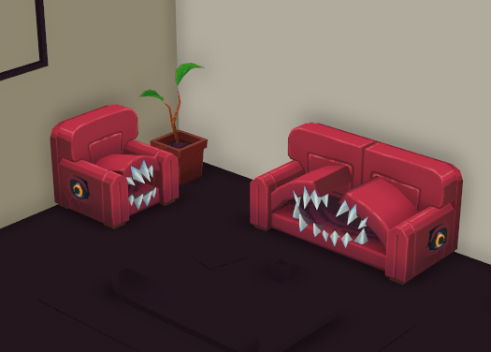
Mechanics
3rd person movement with fixed camera
Possess objects
Set traps
‘Power’ meter to limit player’s abilities
A.I movement and behaviour
Townspeople have different fears
Some townspeople more sceptical than others
Spooperscoopers have unique reactions to player
Line of sight
High scores
Scaring townspeople to death makes them ghosts too

Slide 7
Intended outcomes
Games Design Document
Game Prototype
Tutorial level/ghost house
Town
Cathedral
Ending photo

Slide 8
Possible Future Additions
More levels
Townspeople biographies
Opening cutscene
More cutscenes throughout game
Multiplayer experience
1-4 Ghosts vs 1 Spooperscooper
Ghosts have to scare everyone out of an area without getting caught
Spooperscooper has to catch the ghosts before they scare everyone away

Slide 9
Any Questions?

